Slide 1

Cheap and Free Test Tools
Randall W. Rice, CTAL
www.riceconsulting.com
© 2009 – 2014, Rice Consulting Services, Inc.

Slide 2

At the Start
This will be an interactive session
    Some demos and videos
Screenshots
Helpful hints
I get no compensation from tool vendors, but I do get review licenses for some of the tools.

Slide 3

We Can’t Cover All Tools
I focus on tools you may not have heard about.
I welcome hearing about free and inexpensive tools you have found helpful.
  At the end of each tool type, I’ll ask for your suggestions about other tools.

Slide 4

Constraints
You may find it hard to get your management to consider using an open-source or free tool.
Some companies are heavily invested in commercial tools (that may or may not be the best ones for you), so they keep out any other options.

Slide 5

Common Acceptance Issues
Security
  Code vulnerabilities
Vendor uncertainty
  Open source has none
  Small vendors are often acquired
Support levels
Future tool direction
  Free, paid, or no growth at all

Slide 6

A Strategy For Acceptance
Make the business case in cost vs. benefits.
  Also, bring out the reality of having a free tool vs. no tool.
Include information about companies like Sun, IBM, and Microsoft that have contributed open-source and free software.

Slide 7

Think About Commercial Tools
Security
  Do commercial tools have security issues?
Vendor certainty
  Are larger vendors acquired?
Direction of the tool
  Do major tools fade away?
Support levels
  Are major tools well-supported?

Slide 8

What’s the Answer?
Keep an open mind.
You can be successful with a wide variety of tools if you get a “best fit” for your needs.
Price is not the best way to determine tool quality or applicability to your needs.

Slide 9

Evaluations
Regardless of the tool cost or source, you should do a good evaluation and proof of concept.
Even free tools require an investment of time to:
  Learn
  Install
  Maintain

Slide 10

Your Personal Toolkit
As a tester, it’s good to have your own set of test tools.
  You don’t get locked into one tool set.
  You can learn on your own.
  You can be a value-added resource in your company concerning test tools.
  You can take your tools wherever you go!

Slide 11
Tool Types We Will Cover
Test Design
Test Execution
Test Frameworks
Performance Testing and Monitoring
Test Management
Test Data
Test Evaluation
Defect Tracking
Special Applications – SOA, Load testing, Web testing

Slide 12
Test Design
AllPairs – www.satisfice.com
PICT – www.microsoft.com
PictMaster - http://en.sourceforge.jp/projects/pictmaster/
ACTS - www.nist.gov
More at www.pairwise.org

Slide 13
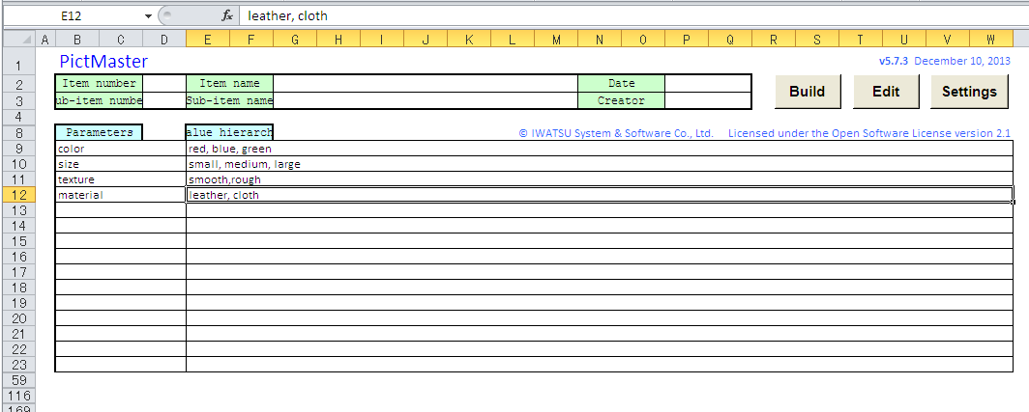
PictMaster
Windows only, must have PICT installed first

Slide 14
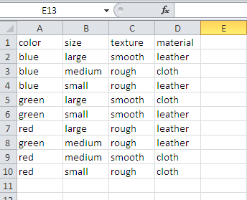
Pictmaster (2)

Slide 15
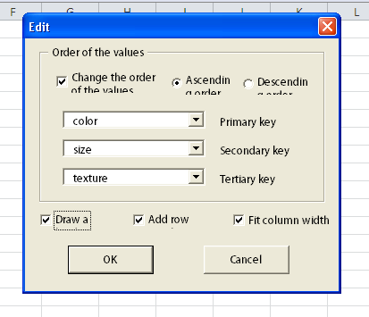
Pictmaster (3)

Slide 16
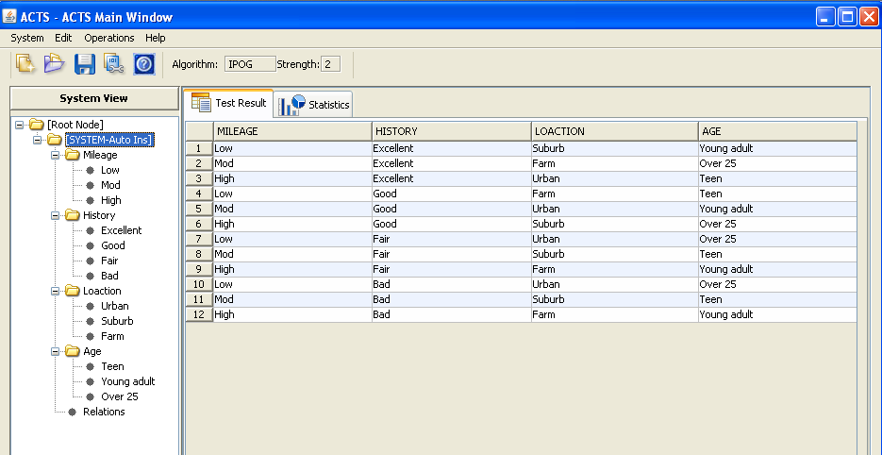
ACTS
Notes:
ACTS is a combinatorial testing tool that can be used to generate t-way test sets. Major features of ACTS include uniform and mixed strength test set generation,
high-level constraints support, and an easy-to-use GUI. ACTS is developed by the US National Institute of Standards and Technology (NIST)
and the University of Texas at Arlington.

Slide 17
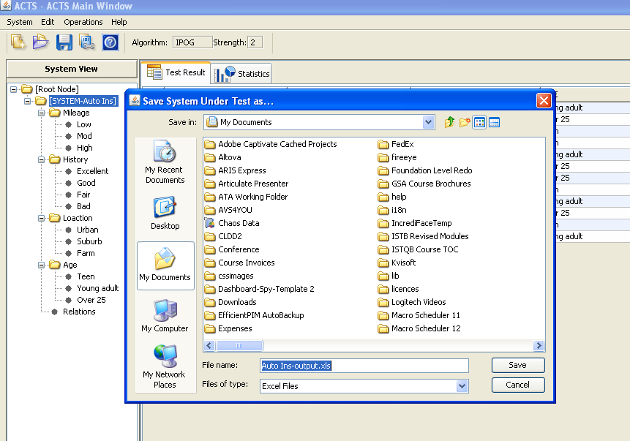
ACTS (2)

Slide 18
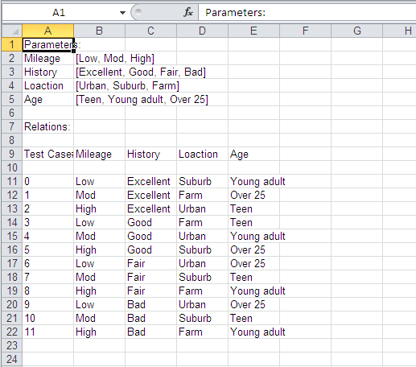
ACTS (3)

Slide 19
Free Mind
Mind mapping for test case design
Windows, Linux and Mac versions
Open source
freemind.sourceforge.net

Slide 20
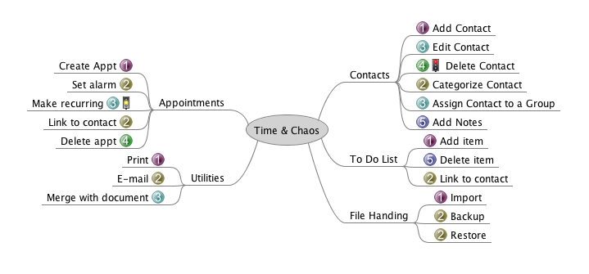
Functional Decomposition with Free Mind

Slide 21
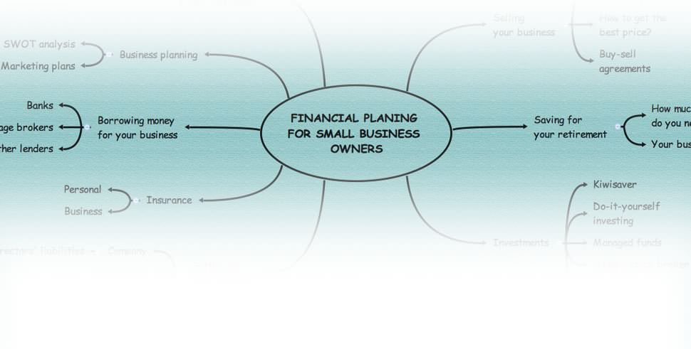
xmind
Xmind is an open source tool for mindmapping, brainstorming and much more.
Free and Pro versions
Mac, Windows, Linux
http://www.xmind.net/

Slide 22
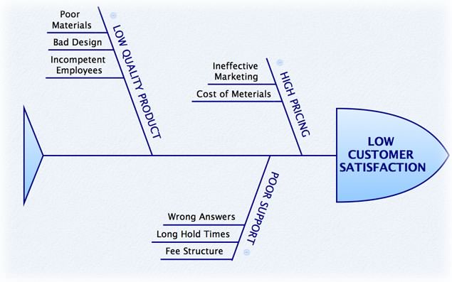
Xmind (2)
Fishbone Diagram

Slide 23
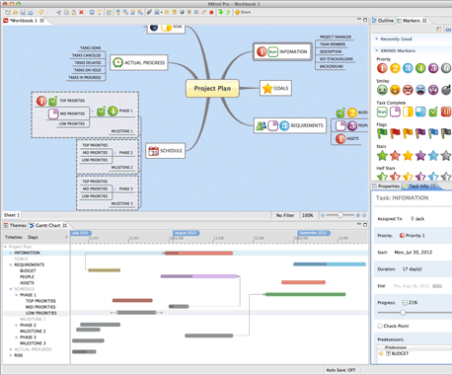
Xmind (3)
Gantt View

Slide 24
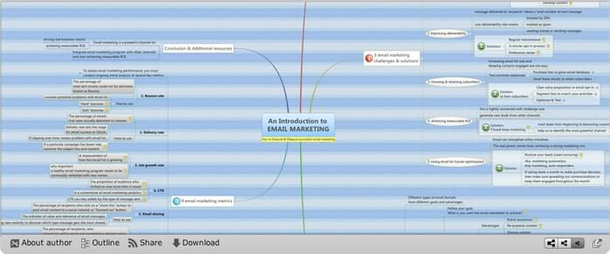
Xmind (4)
Online Sharing

Slide 25

Minimal Essential Test Strategy (METS)
Developed by Greg Paskal
  www.gregpaskal.com
A way to quickly define features and functions to be tested by levels of criticality.
Test time can be estimated along with potential defect severity.
Also available as an iPhone app.
Notes:
Another good method for defining functions to be tested is the Minimal Essential Test Strategy (METS) developed by Greg Paskal. This is a way to quickly define features and functions to be tested by levels of criticality. In addition, test time can be estimated, along with the potential defect impact. You can perform this method by using just an Excel spreadsheet. There is also an iPhone app.

Slide 26

Physical Items
“Items” to be tested that can be “touched”.
  Examples: Buttons, web pages, etc.
These enable functionality, but are not the functions.
These have attributes at various levels of criticality:
  Example: Images
    Critical: Image is present
    High: Image is correct
    Med: Image loads quickly (size)
    Low: Image is clear
Notes:
The first grid is the Physical Test Grid. Physical items are things that can be tangibly accessed or “touched.” For example, people can click on buttons, scroll screens, etc.
Physical items enable functions, but are not the functions. These have attributes at various levels of criticality:
Example: Images have various levels of criticality:
Critical: Image is present
High: Image is correct
Med: Image loads quickly (size)
Low: Image is clear

Slide 27
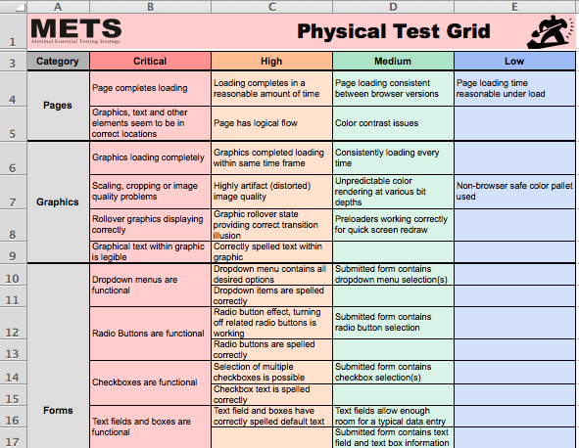
Notes:
This is an example of the Physical Test Grid.

Slide 28


Physical Test Metrics
Shows for each item:
  Estimated time required for testing
  Estimated impact severity
Notes:
As an extension, you can show for each test item the estimated time required for performing the test, along with the estimated impact severity. You can see an example of this on the next page.

Slide 29
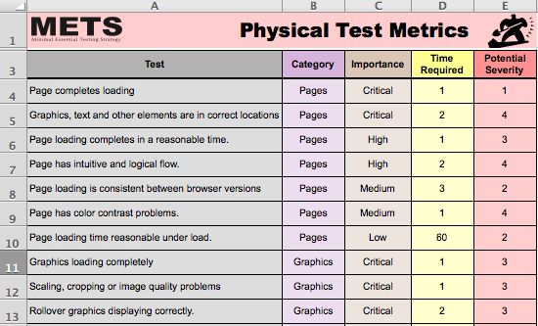
Notes:
This is an example of Physical Test Metrics.

Slide 30
Functions
“Actions” to be tested.
  Examples: Create, cancel, query, etc.
These are things the application can “do.”
Example: Shopping cart functions
  Critical: Can an item be placed into the cart?
  High: Can multiple items be put into shopping cart?
  Medium: Do items consistently carry through purchase session?
  Low: Are related products shown?
Notes:
These are the actions to be tested. Think of a function as something the application can do.
An example would be the shopping cart functions:
Critical: Can an item be placed into the cart?
High: Can multiple items be put into shopping cart?
Medium: Do items consistently carry through purchase session?
Low: Are related products shown?

Slide 31
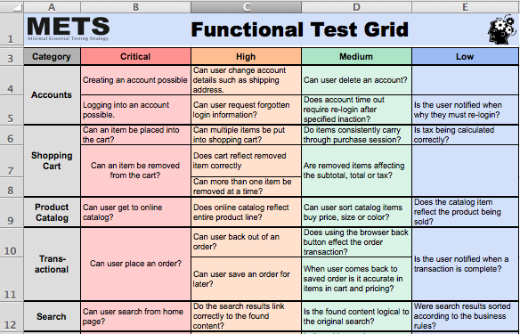
Notes:
This is an example of a Functional Test Grid.

Slide 32
Metrics
Based on estimated test time and assessed potential impact severity.
Items are assessed by:
  Direct testing
    Test pertaining to the obvious change or fix.
  Related testing
    Test pertaining to areas that may be impacted by the changes made.
  Regression testing
    Test you would run on the application regardless of what has changed.
Notes:
Functional metrics are based on estimated test time and assessed potential impact severity. Items are assessed by:
Direct testing, which test functions pertaining to the obvious change or fix.
Related testing, which are tests pertaining to areas that may be impacted by the changes made.
Regression testing, which are tests you would perform regardless of what has changed.

Slide 33
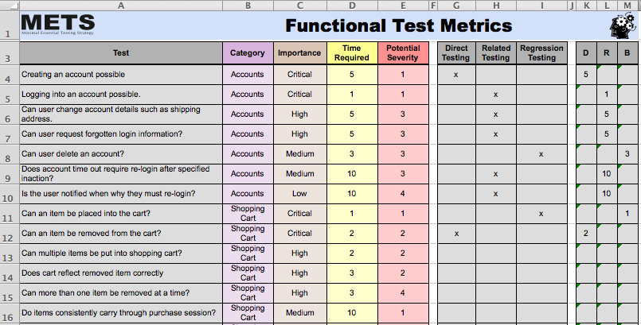
METS Functional Test Metrics
Notes:
This is an example of the Functional Test Metrics.

Slide 34
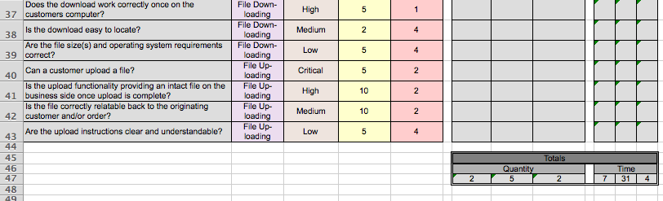
METS Functional Test Metrics (2)
Notes:
This is the lower part of the Functional Test Metrics Grid.

Slide 35
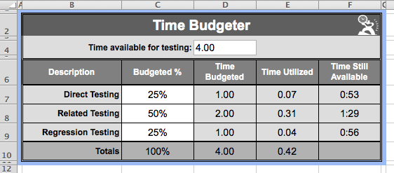
METS Time Budgeter
Notes:
Finally, the Time Budgeter is a simple grid to allocate time based on the levels of direct testing, related testing and regression testing.

Slide 36
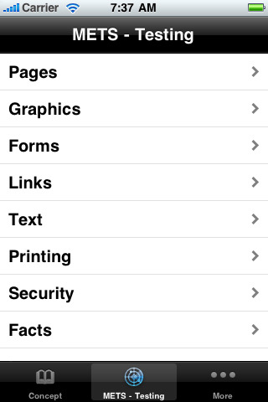
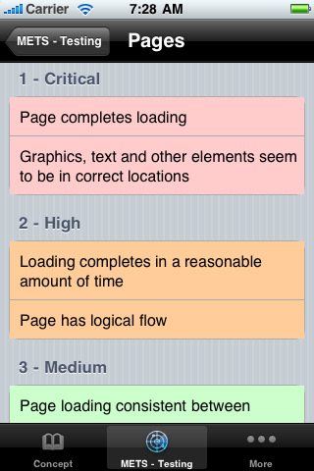
METS iPhone App
Notes:
These are two screenshots from the METS iPhone app.

Slide 37
Dia
Dia is roughly inspired by 'Visio,' though more geared towards informal diagrams for casual use.
Open Source
Has special objects to help draw entity relationship diagrams, UML diagrams, flowcharts, network diagrams, and many other diagrams.
Can export diagrams to a number of formats, including EPS, SVG, XFIG, WMF and PNG, and can print diagrams (including ones that span multiple pages).
http://live.gnome.org/Dia

Slide 38
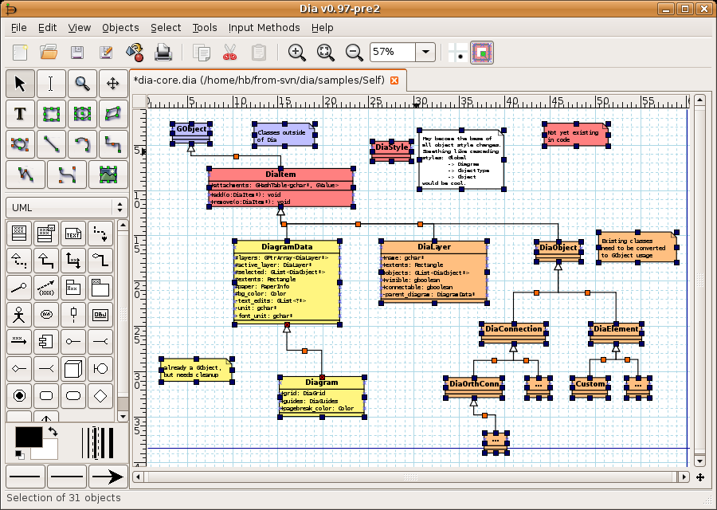

Slide 39
Gliffy
Online diagramming application
Free, standard and pro versions
  $4.95 / month for standard
  $9.95 / month for pro
www.gliffy.com

Slide 40
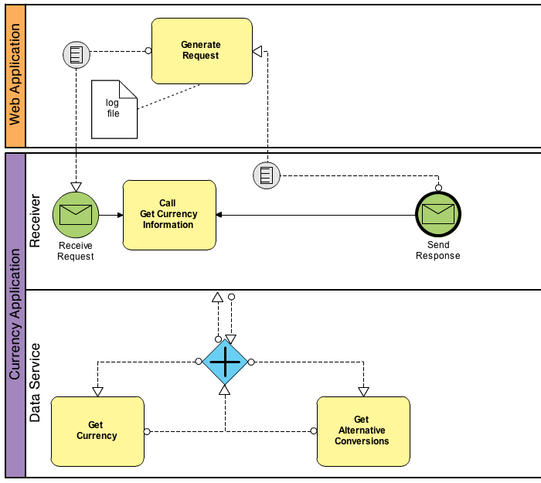
Business Process Diagram
Created in Gliffy

Slide 41
Shapes
Diagramming tool for Mac OS X Snow Leopard
4.99
www.shapesapp.com

Slide 42
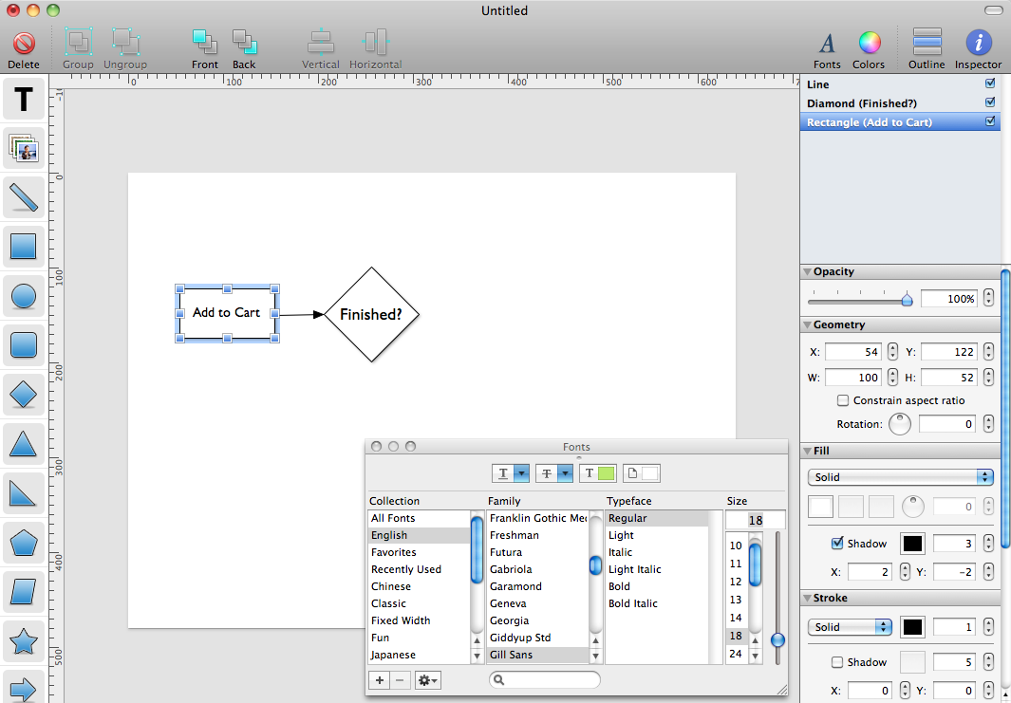

Slide 43
yEd Graph Editor
yEd is a powerful desktop application that can be used to quickly and effectively generate high-quality diagrams.
Create diagrams manually, or import your external data for analysis.
Automatic layout algorithms arrange even large data sets with just the press of a button.
yEd is freely available and runs on all major platforms: Windows, Unix/Linux, and Mac OS.

Slide 44
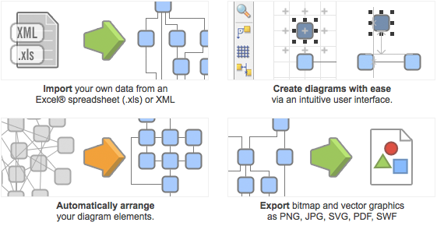
yEd

Slide 45
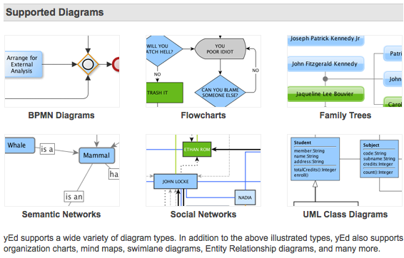

Slide 46
yWorks UML Doclet
yWorks UML Doclet, formerly known as yDoc, is a Javadoc™ extension that automatically generates clear and concise UML diagrams from your software project's classes and integrates them into the generated Java API documentation.
yWorks UML Doclet makes use of the world-class layout algorithms provided by our graph visualization library yFiles to generate the UML diagrams.

Slide 47
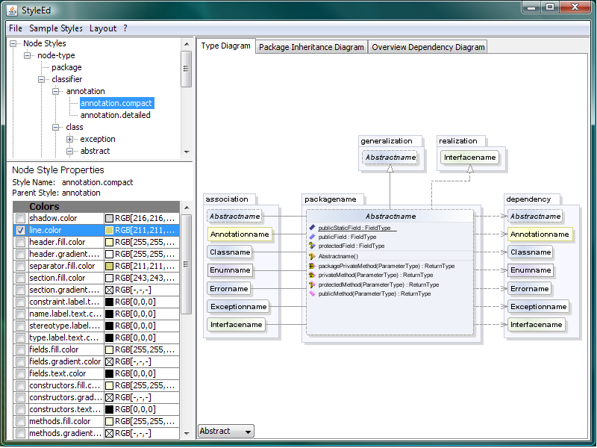

Slide 48
GraphWalker
http://graphwalker.org/
GraphWalker is a tool for generating offline and online test sequences from Finite State Machines and Extended Finite State Machines.
The source code is now at github.
  https://github.com/KristianKarl/GraphWalker

Slide 49
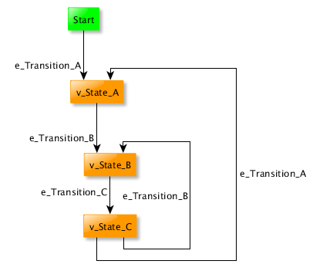
Simple Finite State Machine Model

Slide 50
Prototyping tools

Slide 51
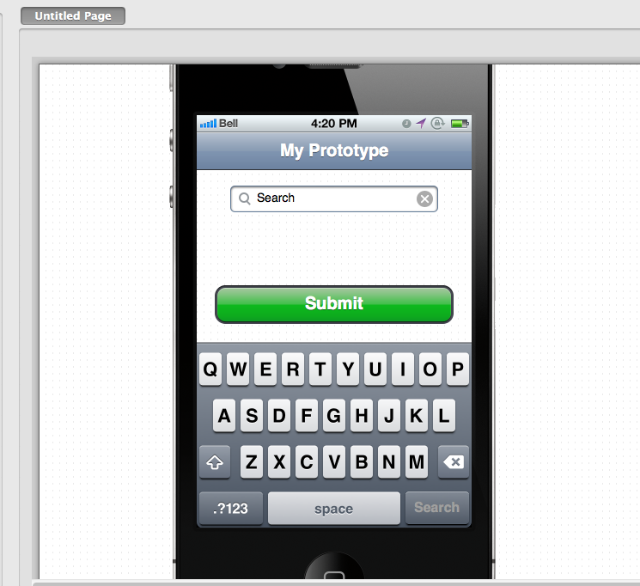
Pencil

Slide 52
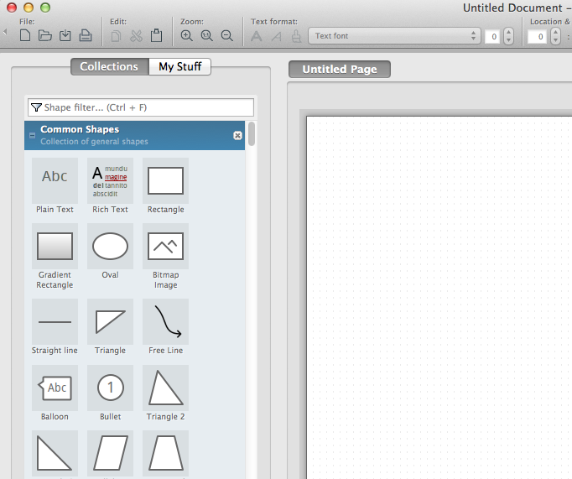
Pencil

Slide 53
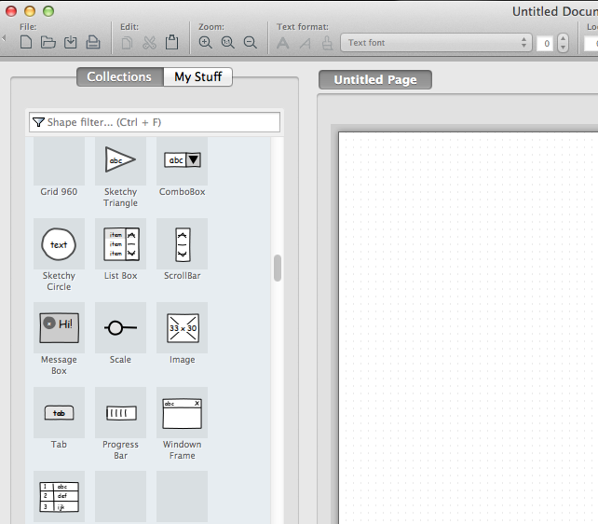
Pencil

Slide 54
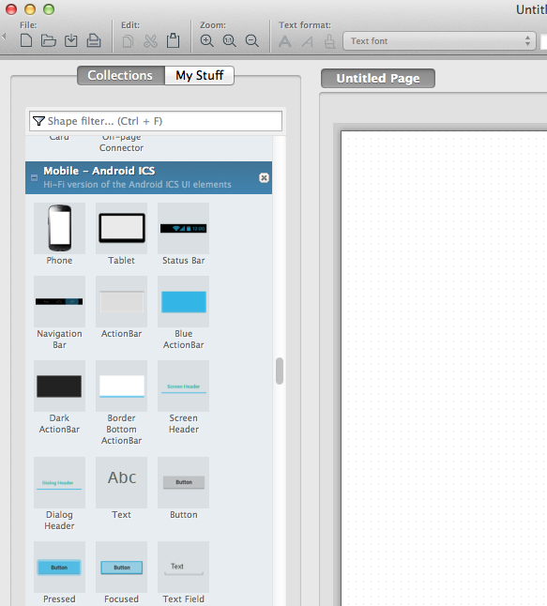
Pencil

Slide 55
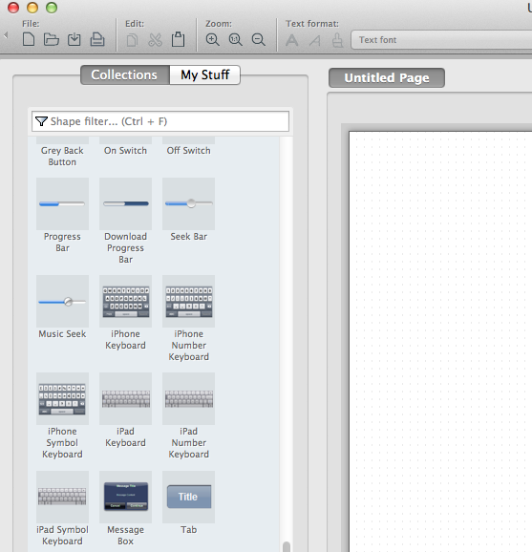
Pencil
Free
Download at:
http://pencil.evolus.vn/
Works on Mac

Slide 56
Business Process modeling

Slide 57
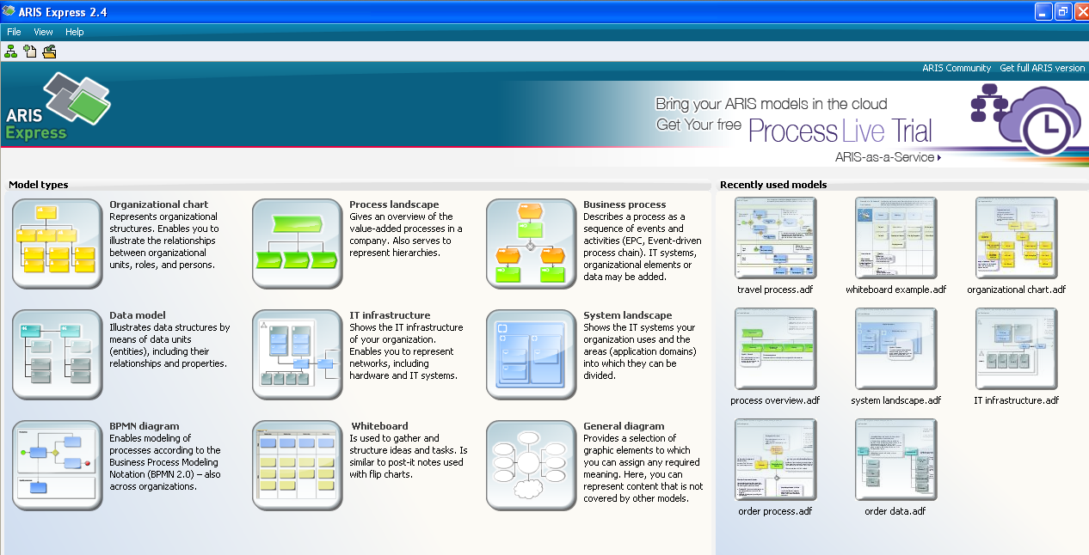
ARIS Express

Slide 58
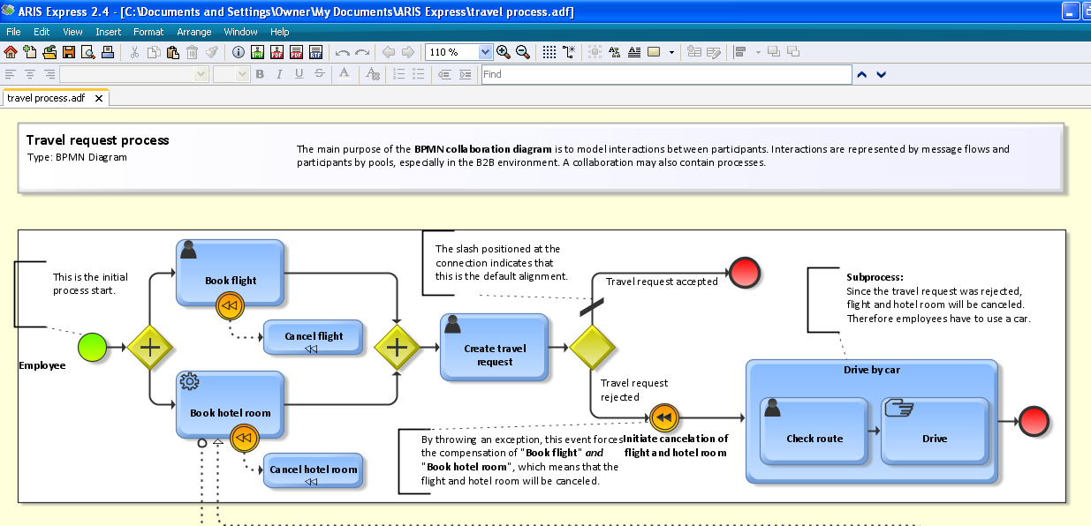
Aris express – example travel process

Slide 59
Aris express
http://www.ariscommunity.com/aris-express
Free
Good documentation
Windows only
Full version available

Slide 60
Others?
______________________________
______________________________
______________________________
______________________________
______________________________
______________________________

Slide 61

Test Execution
Macro Scheduler
  www.mjtnet.com
  Windows only
  Row/Column oriented
    Has object recognition for some Windows objects
    Will execute VB Script
  $29 to $195 per individual license
  $595 for enterprise license
  Like capture/playback, but no comparison features
  Has a very robust scripting language

Slide 62
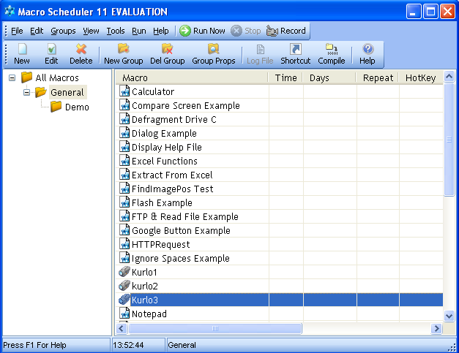
Macro Scheduler Main Interface
Notes:
This is the main user interface of Macro Scheduler. We will examine the key functions.

Slide 63
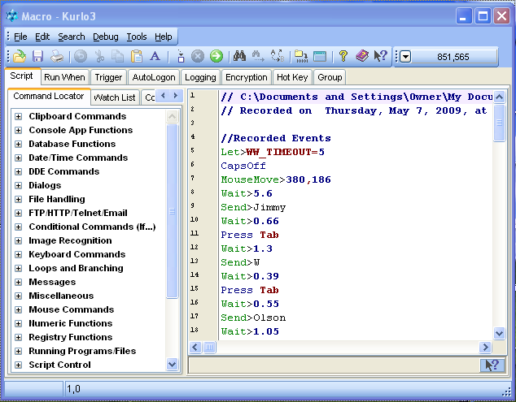
Macro Scheduler Script Editor
Notes:
One of the great features of Macro Scheduler is the robust scripting language.

Slide 64
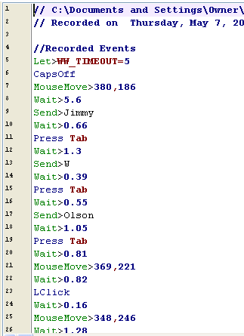
Example Script (1)
Row, column
Data
Keystroke
Wait time
Notes:
You will notice that this tool is row/column oriented, but it can also recognize some objects and incorporate VB Script.

Slide 65
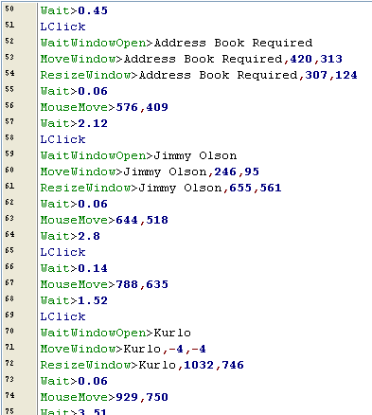
Example Script (2)
Object
Recognition
Duplicated
Data
Notes:
This is an example of object recognition.

Slide 66
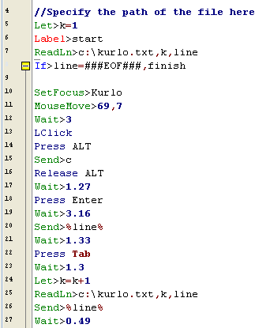
Sample Data-Driven Script
Test Data File
Loop
Read from file
Input to screen
Notes:
In this example we see test data being read and stored in variables.

Slide 67
Selenium IDE
Firefox add-on that records clicks, typing, and other actions to make a test, which you can play back in the browser.
  Not just a recording tool: it is a complete IDE.
  You can choose to use its recording capability, or you may edit your scripts by hand.
  Autocomplete support and the ability to move commands around quickly.
  http://seleniumhq.org

Slide 68
Selenium IDE Features
Easy record and playback
Intelligent field selection will use IDs, names, or XPath as needed
Autocomplete for all common Selenium commands
Walk through tests
Debug and set breakpoints
Save tests as HTML, Ruby scripts, or any other format

Slide 69
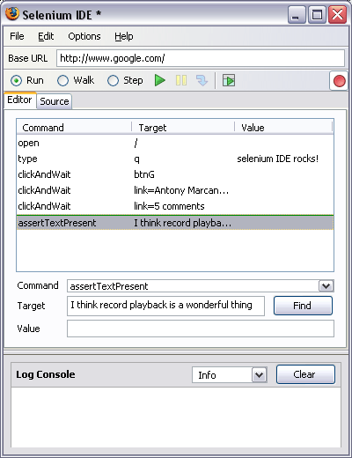
Selenium IDE Features (2)
Support for Selenium user-extensions.js file
Option to automatically assert the title of every page
NEW! Easy customization through plugins

Slide 70
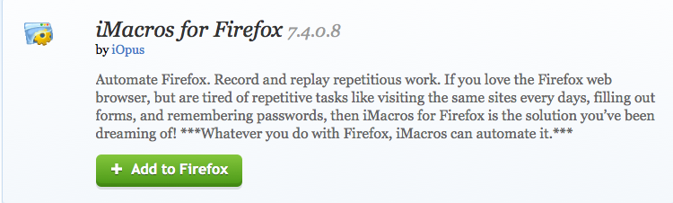
iMacros

Slide 71
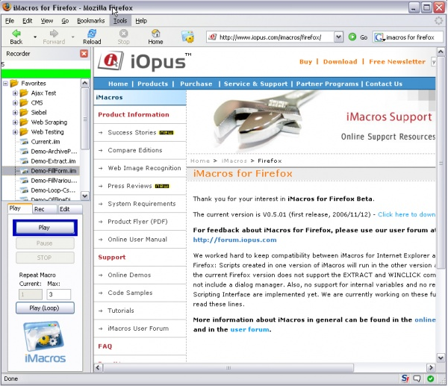

Slide 72
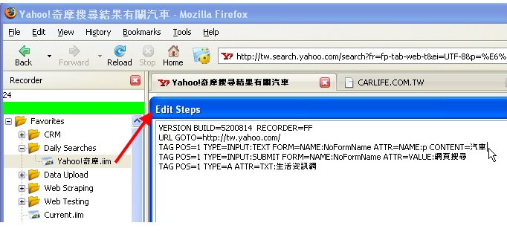

Slide 73
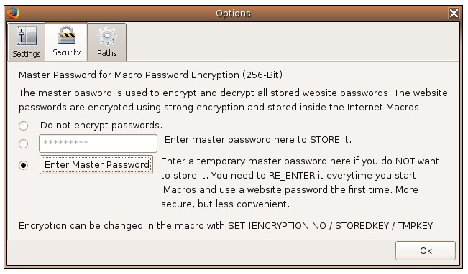

Slide 74
Cubic Test
CubicTest is a graphical Eclipse plug-in for writing Selenium and Watir tests.
CubicTest's test editor is centered around pages/states and transitions between these pages/states.
CubicTest features an innovative test recorder and test runner based on Selenium RC which are fully integrated with the graphical test editor.
Notes:
CubicTest is a graphical Eclipse plug-in for writing Selenium and Watir tests. It makes web tests faster and easier to write, and provides abstractions to make tests more robust and reusable.
CubicTest's test editor is centered around pages/states and transitions between these pages/states. The model is intuitive for both Ajax and traditional web applications and supports most user interaction types. CubicTest features an innovative test recorder and test runner based on Selenium RC which are fully integrated with the graphical test editor. Tests can also run standalone from Maven 2.

Slide 75
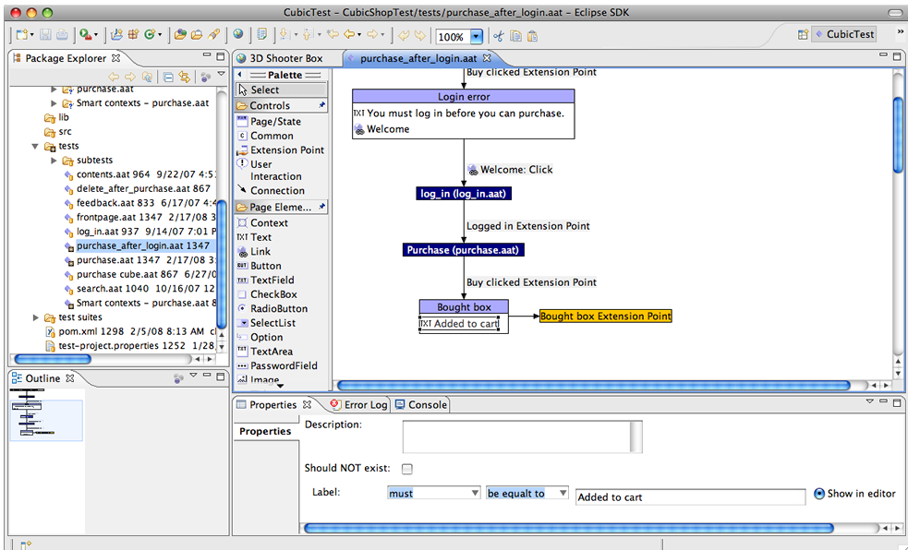
Cubic Test (2)

Slide 76
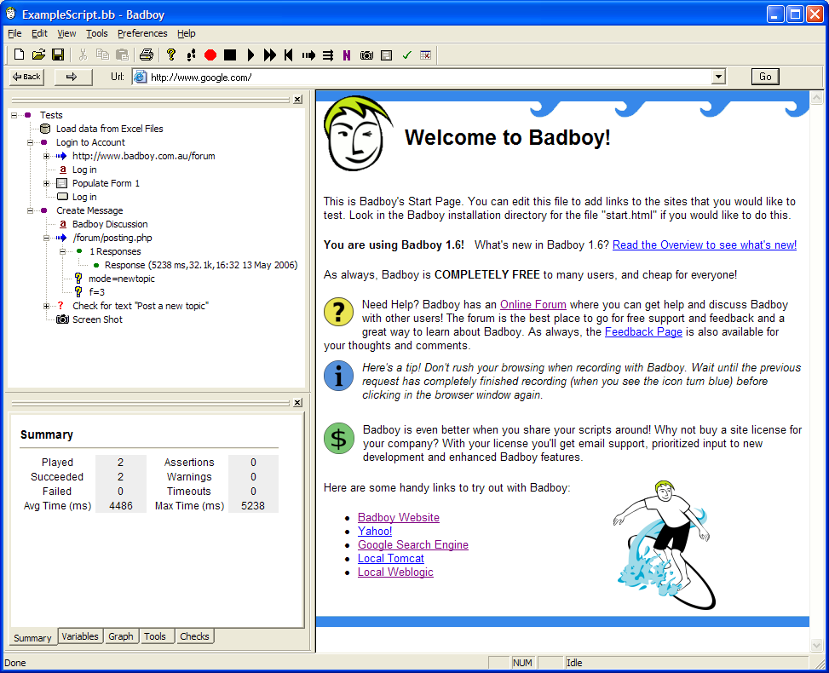
Bad Boy
Notes:
Badboy is a powerful tool designed to aid in testing and development of complex dynamic applications. Badboy makes web testing and development easier with dozens of features including a simple yet comprehensive capture/replay interface, powerful load testing support, detailed reports, graphs and much more!

Slide 77
Bad Boy (2)
Record/playback
Free for individuals and deployments of 5 computers or less & not-for-profits
$45/user license fee otherwise
http://www.badboy.com.au/

Slide 78
Cucumber
Cucumber is a tool that executes plain-text functional descriptions as automated tests.
The language that Cucumber understands is called Gherkin
http://cukes.info/

Slide 79
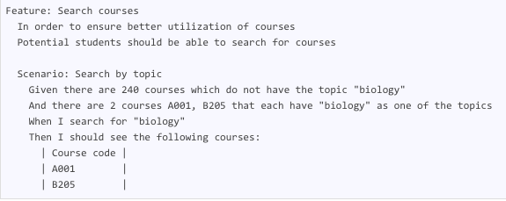
Cucumber Language Example
Notes:
While Cucumber can be thought of as a “testing” tool, the intent of the tool is to support BDD. This means that the “tests” (plain text feature descriptions with scenarios) are typically written before anything else and verified by business analysts, domain experts, etc. non technical stakeholders. The production code is then written outside-in, to make the stories pass.
Cucumber itself is written in Ruby, but it can be used to “test” code written in Ruby or other languages including but not limited to Java, C# and Python. Cucumber only requires minimal use of Ruby programming and Ruby is easy, so don’t be afraid even if the code you’re developing in is not Ruby.

Slide 80
Sikuli
Sikuli is an open source visual technology to automate and test graphical user interfaces (GUI) using images (screenshots).
Sikuli includes Sikuli Script, a visual scripting API for Jython, and Sikuli IDE, an integrated development environment for writing visual scripts with screenshots easily.
You can programmatically control a web page, a Windows/Linux/Mac OS X desktop application, or even an iphone or android application running in a simulator or via VNC.
http://sikuli.org/

Slide 81
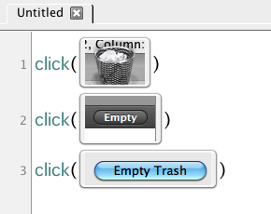
Sikuli Scripting

Slide 82
IcuTest
GUI Unit testing for Windows Presentation Foundation
Free
Test Generator is a tool that automatically creates GUI unit tests for your application. Just specify your assembly (executable or DLL) and Test Generator will inspect your assembly for UI components and generate unit tests automatically.
http://www.nxs-7.com/icu/Default.aspx

Slide 83
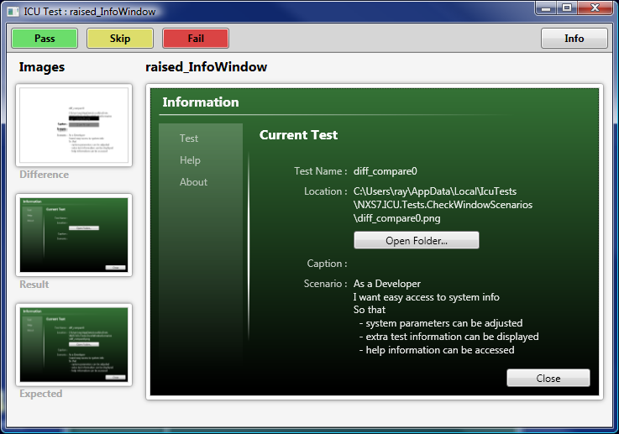

Slide 84
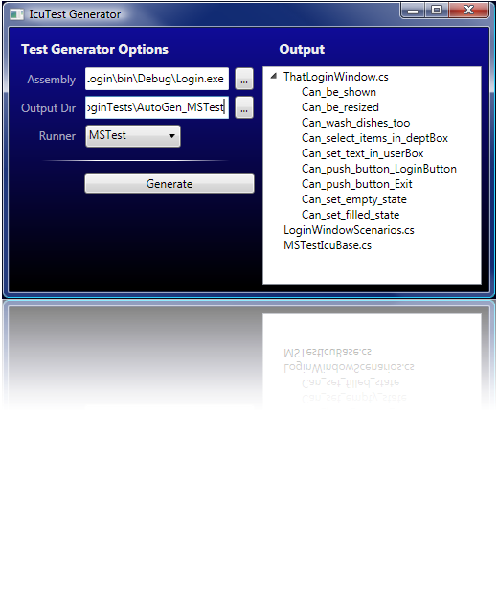
IcuTest Test Generator

Slide 85
Fake
Mac OS X Web Test Automation
  Forms
  Screenshot capture
  Assertions
  Error handling
$29.95
www.fakeapp.com

Slide 86
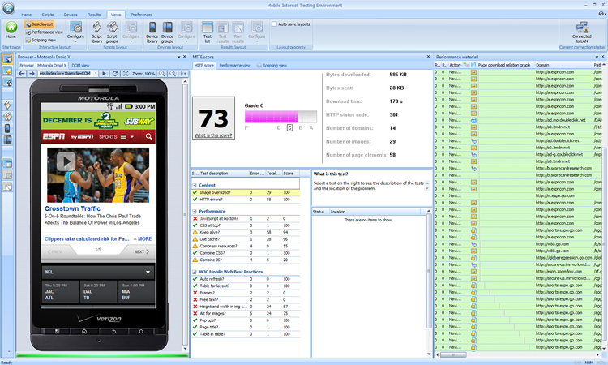
Keynote mite

Slide 87
Other Free Test Execution Tools
FitNesse - http://fitnesse.org
WATIR - http://watir.com/
Apodora - http://sourceforge.net/projects/apodora/
AutoIT - http://www.autoitscript.com/autoit3/index.shtml
Auto Hot Key – www.autohotkey.com
Frankenstein – http://frankenstein.openqa.org/
WET - Commercial grade open source Web automation testing tool - http://wet.openqa.org
Grease Monkey
  http://testertools.com/browsers-based-tools/grease-monkey-web-testing-tool-with-scripts/

Slide 88
Others?
______________________________
______________________________
______________________________
______________________________
______________________________
______________________________

Slide 89
Test Automation Frameworks
Our working definition:
  A framework is a hierarchical directory that encapsulates shared resources, such as a dynamic shared library, image files, localized strings, header files, and reference documentation in a single package.

Slide 90
Open Source Frameworks
Open2Test
  http://www.open2test.org
Robot Framework
  http://code.google.com/p/robotframework/
STAF – Software Testing Automation Framework
  http://staf.sourceforge.net/
SAFS - Software Automation Framework Support (SAS)
  http://sourceforge.net/projects/safsdev/

Slide 91

Open2Test
Open2Test is a keyword-driven automation framework that works with HP QuickTest Professional (QTP) and many other test execution tools.

Slide 92
Open2Test (2)
Allows testers to develop test cases using Microsoft Excel and a list of keywords.
When the test is executed, the framework processes the Excel workbook and calls functions associated with the keywords entered in the Excel spreadsheet.

Slide 93

Framework Architecture

Slide 94
Open2Test (3)
These keyword functions in turn perform specific actions against the application under test (AUT).
  The framework interprets the keyword and executes a set of statements in the program.

Slide 95

Framework Flow

Slide 96
Open2Test (4)
With this framework in place, applications can be automated without starting from scratch.
  Testers simply use the application independent keywords and create extra application-specific keywords.

Slide 97
Open2Test Features
Use of variables
  Variables can be defined and used across the generated test script.
Conditional checking
  Conditional constructs such as ‘if’ can be implemented using keywords to handle different flows based on various conditions.

Slide 98
Open2Test Features (2)
Data-driven testing
  This framework supports data-driven testing by importing data from an external data sheet.
Reports
  Customized reporter messages can also be used to perform effective analysis on execution reports.

Slide 99
Open2Test Features (3)
Calling functions and reusable actions
  Common functions or actions can be triggered through keywords.
Keyboard inputs
  This plug-in is included to perform keyboard actions on the specified test object.

Slide 100
Open2Test Features (4)
Date/time functions
  The date/time function plug-in is included to perform different operations on date/time.
Exception handling
  Runtime errors can be effectively handled and reported using this framework.
Handling object (Web or windows)
  Some operations can be performed on the Web or as a Windows Object using keywords, depending on the execution tool.
Learn More at http://www.open2test.org

Slide 101
Robot framework
Robot Framework is a generic test automation framework for acceptance testing and acceptance test-driven development (ATDD).
Has easy-to-use tabular test data syntax and utilizes the keyword-driven testing approach.
Can be extended by test libraries implemented either with Python or Java, and users can create new keywords from existing ones using the same syntax that is used for creating test cases.

Slide 102

Robot framework (2)

Slide 103

Robot framework (3)

Slide 104

Robot framework (4)

Slide 105
Selenium Library
SeleniumLibrary is a Robot Framework test library that uses the popular Selenium web testing tool internally.
It provides a powerful combination of simple test data syntax and support for different browsers.
In addition to standard web testing, the library also supports testing Adobe Flex/Flash applications.
http://code.google.com/p/robotframework-seleniumlibrary/
http://code.google.com/p/robotframework-seleniumlibrary/wiki/Demo

Slide 106
STAF
The Software Testing Automation Framework (STAF) is an open source, multi-platform, multi-language framework designed around the idea of reusable components, called services (such as process invocation, resource management, logging, and monitoring).
http://staf.sourceforge.net/
Notes:
STAF removes the tedium of building an automation infrastructure, thus enabling you to focus on building your automation solution. The STAF framework provides the foundation upon which to build higher level solutions, and provides a pluggable approach supported across a large variety of platforms and languages.

Slide 107

STAF Overview
This is simply an overview of this environment framework.
  You can see full documentation at http://staf.sourceforge.net/
Notes:
In this module, our goal is to present this framework and explain more about it. If you want to download and install the framework on your system, you can find it and the documentation at http://staf.sourceforge.net.

Slide 108
STAF Overview (2)
Peer-to-peer pluggable framework geared towards test automation
History
  Created at IBM Austin in 1998
  Corporate funded (via QSE) since 1999
  Open-sourced (on SourceForge) in 2001
  Licensed under the Eclipse Public License (EPL) V1.0

Slide 109
STAF Overview (3)
User Community
  240+ IBM teams (world-wide)
  220+ external companies
  280k+ downloads of STAF and associated plug-ins since 4Q/2001
  Consistently ranked as one of the Top 50 projects on SourceForge.net

Slide 110
STAF Overview (4)
An open source automation framework
A remote test agent to control tests on multiple machines
Designed around the idea of reusable components, called services
Developed by IBM, made open source because of their use in Linux testing

Slide 111
STAF Overview (5)
Runs as a daemon process, called STAFProc, on each system
Operates in a peer-to-peer environment; in other words, there is no client-server hierarchy.

Slide 112

STAF Overview (6)
STAF operates in a peer-to-peer environment; in other words, there is no client-server hierarchy among machines running STAF

Slide 113
STAF Objectives
STAF was designed with the following objectives in mind:
  Minimum machine requirements - This is both a hardware and a software statement.
  Easily useable from a variety of languages, such as Java, C/C++, Rexx, Perl, and Tcl, or from a shell (command) prompt.
  Easily extendable - This means that it should be easy to create other services to plug into STAF.

Slide 114
STAF Objectives (2)
To make it easier to create automated test cases and workloads.
To increase the efficiency, productivity, and quality of your testing by improving your level of automation and reuse in individual test cases as well as the overall test environment.

Slide 115
STAF as Automation Toolkit
STAF is quick and easy to get started with
  Takes less than 3 minutes to get running on most systems
STAF is very easy to use
  All services have built-in syntax help
  All services are available from the command line
STAF provides many valuable built-in services
  Many more are available for download
  Writing your own services is very straightforward

Slide 116
STAF Supported Platforms
STAF is available for the following platforms
  Windows: 2000, 2003, XP, Vista, Server 2008 (Intel, AMD64, IA/64)
  Linux: All platforms (i386, AMD64, IA/64, PPC64, PPC32, zLinux32, zLinux64)
  AIX 5.1+ (32- and 64-bit)
  Solaris 2.6+ + (Sparc 32/64, x64, x86)
  HP-UX 11.00+ (PA-RISC, IA/64)
  FreeBSD 4.10+
  Mac OS X 10.4+ (i386, PPC)
  OS/400 V5R2+
  z/OS 1.4+ (32- and 64-bit)

Slide 117
STAF Supported Languages
STAF supports the following languages
  Java, C/C++
  Perl, Python, Tcl, Rexx, Shell-script
  Ant
  Command line
STAF “feels” the same across all platforms and languages
There is also a command line interface

Slide 118
The STAF Web Site
The main STAF web site is
  http://staf.sourceforge.net
From this web site you can:
  Submit bugs and feature requests
  View the STAF source code
  Download the STAF binary files
  Download STAF services
  View STAF documentation
  Access Mailing Lists to view, search, and post messages (Help, Announcements)
  Access Forums to view, search, and post messages

Slide 119

STAF Web Site

Slide 120

STAF Download Page

Slide 121
Performance Testing & Monitoring Tools
Paessler Web Server Stress Tool
SmartInspect
loadUI
SOASTA CloudTest Lite
BrowserMob
Chess

Slide 122
SmartInspect
.NET, Java and Delphi logging tool for debugging and monitoring software applications.
Helps identify bugs, find solutions to user-reported issues and gives a precise picture of how software performs in different environments.
One-time license
  $299 single user
http://www.gurock.com/smartinspect/

Slide 123


Slide 124
Network Monitoring
Axence NetTools Pro – www.axencesoftware.com
FREE and very comprehensive set of network administration tools:
  NetWatch - network monitoring with alerting, real-time & historical charts;
  WinTools lists exhaustive system information from Windows computers;
  Port scanner; network scanner;
  NetStat lists local inbound & outbound connections;
  TCP/IP workshop for low level service testing; ping; fast traceroute;
  DNS lookup; bandwidth test tool; SNMP browser and more.

Slide 125

Axence NetTools Pro
Notes:
Axence NetTools Pro is a FREE and very comprehensive set of administration tools:
- NetWatch: host monitoring with alerting, real-time & historical charts of response time & packet lost; e-mail & sound notifications available when a host is down; nodes names identification.
- WinTools: lists exhaustive system information from Windows computers: running processes & services, registry, event log, disk, memory & CPU information, etc.
- Port scanner: checks for all open ports and running services. It can discover some Trojans/spyware.
- Network scanner: discovers all nodes in a remote network, their IP/MAC and services running on them.
- NetStat: displays your computer's inbound and outbound connections, lists all open TCP/UDP ports, with the remote IP address & the process using the connection.
- TCP/IP workshop: establishes low-level TCP/UDP connections to troubleshoot and test network services. It can send raw data to any remote port.
- SNMP Browser: a full SNMP browser, so easy you can use it even if you don't know a thing about SNMP.
- Other tools: fast traceroute shows information about every host on the route, its response time, and packets lost (full trace within 1 second). Lookup is like nslookup, but it shows you all DNS and WHOIS records at once. Bandwidth tool will measure network performance. NetCheck - with this tool you can check the quality of network hardware in your LAN.
Axence NetTools Pro is a freeware application - it just requires a simple, free activation.
Languages of the program: English, German and Polish.
Axence NetTools Pro is a FREE and very comprehensive set of administration tools:
- NetWatch: host monitoring with alerting, real-time & historical charts of response time & packet lost; e-mail & sound notifications available when a host is down; nodes names identification.
- WinTools: lists exhaustive system information from Windows computers: running processes & services, registry, event log, disk, memory & CPU information, etc.
- Port scanner: checks for all open ports and running services. It can discover some Trojans/spyware.
- Network scanner: discovers all nodes in a remote network, their IP/MAC and services running on them.
- NetStat: displays your computer's inbound and outbound connections, lists all open TCP/UDP ports, with the remote IP address & the process using the connection.
- TCP/IP workshop: establishes low-level TCP/UDP connections to troubleshoot and test network services. It can send raw data to any remote port.
- SNMP Browser: a full SNMP browser, so easy you can use it even if you don't know a thing about SNMP.
- Other tools: fast traceroute shows information about every host on the route, its response time, and packets lost (full trace within 1 second). Lookup is like nslookup, but it shows you all DNS and WHOIS records at once. Bandwidth tool will measure network performance. NetCheck - with this tool you can check the quality of network hardware in your LAN.
Axence NetTools Pro is a freeware application - it just requires a simple, free activation.
Languages of the program: English, German and Polish.
Product homepage: http://www.axencesoftware.com

Slide 126
Paessler Web Server Test
www.paessler.com
  Pro edition single user - $249
    100 Concurrent virtual users
  Enterprise edition single user - $750
    Up to 10,000 concurrent virtual users
  Enterprise edition 5 user - $1,449
  Enterprise edition site license - $2,895

Slide 127


Slide 128
Paessler PRTG Network Monitoring
www.paessler.com
  Free for up to 10 sensors
  Up to 100 sensors - $400
  Up to 500 sensors - $1,200

Slide 129


Slide 130


Slide 131


Slide 132


Slide 133
Other monitoring tools
PerfMon – Windows
Wireshark
Nagios
Iometer
  Iometer is an I/O subsystem measurement and characterization tool for single and clustered systems.
  It is used as a benchmark and troubleshooting tool and is easily configured to replicate the behavior of many popular applications. One commonly quoted measurement provided by the tool is IOPS.
  http://www.iometer.org/

Slide 134

Iometer

Slide 135
Memory Test Tools
Memory Validator
  The vendor, Software Verification, provides software tools for compiled languages and dynamic languages.
  The toolset concentrates on the core activities of code coverage, memory leak detection, performance profiling, deadlock detection and flow tracing.
  Pricing for some products is free, and ranges from $199 USD to $695 USD for singe-seat suite licensing. ($4,170 USD for 10 developers)

Slide 136

Memory Validator
Memory Leaks

Slide 137

Memory Coverage

Slide 138
loadUI
loadUI is a free and open source cross-platform Load Testing solution.
With a visual, drag-and-drop interface, it allows you to create, configure and redistribute your Load Tests interactively and in real-time.

Slide 139
loadUI
loadUI generates scalable, high-volume and real-world load from any number of local and remote computers.
In a single test environment, loadUI provides complete test coverage and supports all the standard protocols and technologies.
www.smartbear.com

Slide 140


Slide 141


Slide 142


Slide 143


Slide 144


Slide 145


Slide 146


Slide 147
SOASTA CloudTest Lite
CloudTest® Lite, SOASTA’s free downloadable edition, delivers rapid test creation and real-time analytics for functional testing and frequent, lower-scale performance testing throughout the application development life cycle.
Free for 100 virtual users or less

Slide 148
SOASTA CloudTest Lite (2)
Build, compose, run and analyze functional and performance tests of any complexity
Validate Web and mobile applications up to 100 simultaneous users
Run tests as often as needed in every phase of development and delivery
Test modern web technologies like HTML5, Flash/Flex and Silverlight as well as SOAP and REST web services

Slide 149
SOASTA CloudTest Lite (2)
Analyze end-to-end performance with real-time, in-memory analytics during test execution
Build tests that can be run at large scale with CloudTest On-Demand or other Editions
Evaluate CloudTest for larger scale and broader deployment for your team
http://www.soasta.com/cloudtest/lite/

Slide 150

SOASTA CloudTest Lite (3)

Slide 151

SOASTA CloudTest Lite (4)

Slide 152

SOASTA CloudTest Lite (5)

Slide 153
Browser Mob
Cloud-based performance testing and monitoring.
Some free plans and open source products
  Free – 100 Virtual Users
Other plans start at $49/mo for monitoring and $499 for performance testing.
https://browsermob.com/performance-testing

Slide 154
chess
Systematic Concurrency-Testing Tool
CHESS is a tool for systematically testing multithreaded code. Given a concurrent test, CHESS systematically drives the test along all possible thread interleavings.
It uses model-checking techniques to explore effectively the enormously large state space of interleavings and provides quantified coverage guarantees.
CHESS can check for assertions, deadlocks, livelocks, and data races.
On finding an error, CHESS can reproduce the thread interleaving that exposed an error.
CHESS is research tool developed by Microsoft Research.
Visit http://research.microsoft.com/projects/CHESS/ for more information.

Slide 155
Other Notable Free Load Test Tools
Apache Jmeter - http://jakarta.apache.org/jmeter/
fwptt - http://fwptt.sourceforge.net/
  For web applications
The Grinder - http://grinder.sourceforge.net/
  For Java applications
OpenSTA - http://www.opensta.org/

Slide 156
Others?
______________________________
______________________________
______________________________
______________________________
______________________________
______________________________

Slide 157
Test Management
Testopia
  Testopia is a test case management extension for Bugzilla.
  It is designed to be a generic tool for tracking test cases, allowing for testing organizations to integrate bug reporting with their test case run results.
  Though it is designed with software testing in mind, it can be used to track testing on virtually anything in the engineering process.
  http://sourceforge.net/projects/testopia

Slide 158

Testopia

Slide 159
qaManager
Web-based application used for keeping track of engineering and customer releases of Software Projects, Resource allocations and related information.
It helps QA Managers to keep track of releases effectively.Powered by OpenXava and Java.
http://sourceforge.net/projects/qamanager

Slide 160

QAManager (2)

Slide 161
testmaster
A test case logging, reporting and test automation tool, much like the commercial product Test Director.
http://testmaster.sourceforge.net/

Slide 162


Slide 163


Slide 164


Slide 165


Slide 166


Slide 167
Zeta Test
Zeta Test is an integrated test management environment that enables you to perform black-box tests, white-box tests, regression tests or change management tests of software applications.
Zeta Test helps you to plan, perform, log, monitor and document the tests, and then to evaluate the test results.
Cost – Free
www.zeta-test.com

Slide 168

Notes:
Selection of test cases for a test plan

Slide 169
XQual
Free at http://www.xqual.com
XStudio is a fully-graphical application developed in Java (so theoretically deployable on any OS).
All of the data are organized within trees for more flexibility.
Integrated management - All entities involved in the QA/testing projects are managed by XStudio.
  This makes lots of metrics/statistics/status generation much more easier.

Slide 170


Slide 171
QA Book
Windows-based
Allows you to create, edit and manage requirements, test cases, defects, environments, project success criteria, reporting, automated testing and more.
http://www.freetestmanagementtool.com/Free

Slide 172

Notes:
This is the Test Case edit window. The most important concept to grasp is that of the different types of Test Cases. For each Test Case type you will need to specify different types of data. If you change the 'Script Type:' option you will see the 'Test Case Steps' pane change accordingly. In the screenshot below the 'Test Case Steps' pane is for a Website project (Webscript). Web scripts are designed to allow you to test web sites against multiple or singular browsers. The first step must always contain a URL to ensure that Vienna has a starting point. You can add a URL into any of the steps thereafter but normally you would want the user to navigate through the site following the steps described. You should input a URL, the action you want the user to complete and the expected result of the step.
You may also associate a requirment with a test case in this window.
Source:http://www.freetestmanagementtool.com/ViennaUsageGuidewithScreens/ViennaTestCasesModule.aspx

Slide 173

Notes:
As you start executing yout Test Cases (using the Test Runner) and either pass, fail or raise defects against them, the Stauts on the main Test Cases window will automatically change. You will also notice it captures the time taken (Duration) to run that Test Case. If you have created multiple Test Steps for a Test Case (which you may not necessarily want to do if you are running an agile test project) you will notice in the screenchot below you can see all Test Steps for the selected Test Case at the foot of the main Test Case window, and their individual status.
http://www.freetestmanagementtool.com/ViennaUsageGuidewithScreens/ViennaTestCasesModule.aspx

Slide 174

Notes:
If you are asked for your defect to be autoamtically captured you will notice that almost all of the fields have been pre populated including which operating system and web browser the defect was raised against. Vienna also captures all of the running processes and whether or not they were responding and places this information in the Notes field. Vienna will also capture a screenshot of the website/application under test at the time of raising an automatic defect. You can take a look at the screenshot by double clicking the image within the Image attachments screen.
Source:
http://www.freetestmanagementtool.com/ViennaUsageGuidewithScreens/ViennaTestCasesModule.aspx

Slide 175

Notes:
When you click on the Defects module link in the bottom left hand corner of the Vienna Window, you will see a list of defects raised against your project.
Source:
http://www.freetestmanagementtool.com/ViennaUsageGuidewithScreens/ViennaTestCasesModule.aspx

Slide 176

Notes:
Vienna displays a number of graphs to a user, within the reports section, to aid in assessing project completeness. Vienna also provides the ability for a user to automatically generate a word document report in either Microsoft Word 2003, 2007 and 2010. You can click on any of the graphs listed in the left pane of the reports section as shown below. Within the graphing area you also have the control to select which graph type you prefer to use. Simply select the graph type from the drop down and this should be applied to all graphs.
Source:
http://www.freetestmanagementtool.com/ViennaUsageGuidewithScreens/ViennaTestCasesModule.aspx

Slide 177

Notes:
When you wish to generate a documented report from Vienna you should start by configuring your Report Settings, by clicking on that option on the left. You will then see this screen.
You can select each entity or the module flag to include or exclude an entity from the report you generate. In the Report Template section you can choose the template for the document you wish to generate and the location Vienna should generate the report to. If you click on Print Preview at any time from the Vienna Toolbar you will also be able to see your report with its current settings. To utilise your document templates you should open the current document template, save it as a different filename and then edit it. Once you have changed the document template you want to use you need simply browse to the template file and select it from the template selection. The output directory for the report can be specified in the same manner. If you generate Reports with the same name Vienna will automatically append a time stamp to each report and not replace any previously created.
You may have noticed the 'Apply Filter' link in the 'Requirements' report configuration settings. You can click this link to launch the Apply Filter window. You can specify what is included and excluded in your report by moving entities from or to the included and excluded columns (this functionality exists in the 'Test Cases' and 'Defects' report settings too). Once you are happy you can then click on the 'Generate Report' button on the top menu bar to create your Microsoft Word report.
Source:
http://www.freetestmanagementtool.com/ViennaUsageGuidewithScreens/ViennaTestCasesModule.aspx

Slide 178
Bromine
Part of the Selenium suite of tools
Web-based QA tool for Selenium, that enables you to easily run Selenium-RC tests and view the results.
It scales from the single tester that just wants to run some tests without all the hassle to the corporate solution with multiple user-groups and hundreds of test cases.
http://bromine.seleniumhq.org/

Slide 179
TestLodge
Online test case management tool, allowing you to manage test plans, test cases and test runs.
4 plans from $12 to $99 / month
www.testlodge.com

Slide 180
TestLink
TestLink is web based Test Management system.
The latest documentation is available on www.teamst.org or testlink.sourceforge.net.
http://www.teamst.org

Slide 181


Slide 182

Test Suite View

Slide 183

Test Run View

Slide 184
TestRail
Web-based, hosted on your own server
Track and follow the status of individual tests, milestones and projects with dashboards and activity reports.
One-time licensing
  Ranges from $239 (1 user) to $7,000 (50 users)
http://www.gurock.com/testrail/

Slide 185


Slide 186


Slide 187
Test Run
http://www.runtestrun.com/
Web-based, hosted
Pricing from $10/mo (single user) to $50/mo. (unlimited users)

Slide 188


Slide 189


Slide 190


Slide 191


Slide 192
RTH - Requirements and Testing Hub
An open source tool for managing requirements and test cases.
Available for download, but seems to be inactive in terms of maintenance.
http://sourceforge.net/projects/rth/

Slide 193


Slide 194


Slide 195


Slide 196


Slide 197
Axiom
Free
Build and manage requirements and use cases in an agile environment.
Features such as tracing, reporting and history making it effortless to increase software quality and reduce complexity.
www.iconcur-software.com

Slide 198
ICE Scrum
Open source
Agile scrum management
Helps in implementing the key agile practices: vision, features, user stories, effort estimation with Planning Poker, task board, etc.
Tracks stories, defects and more.
http://www.icescrum.org/en/

Slide 199

Ice scrum (2)
Main Dashboard

Slide 200

Ice scrum (3)
Cumulative Stories

Slide 201

Ice scrum (4)
Tasks by Sprint

Slide 202
Others?
______________________________
______________________________
______________________________
______________________________
______________________________
______________________________

Slide 203
Test Data Generation
Generatedata.com
  www.generatedata.com
  Creates test data in a variety of forms:
    Text, cvs, XML, Excel, SQL
  Free and Cheap Subscriptions Available
DBFeeder - Free
  Automatically generate test data for Oracle Databases which fits primary and foreign keys of tables.
  http://dbfeeder.sourceforge.net/index.html

Slide 204


Slide 205


Slide 206
Others?
______________________________
______________________________
______________________________
______________________________
______________________________
______________________________

Slide 207
Test Evaluation
Beyond Compare
  www.scootersoftware.com
  $30/single user, volume discounts
Exam Diff and DiffNow (online)
  www.prestosoft.com
  Free and Pro versions
  $35/single user, volume discounts
UltraCompare
  http://www.ultraedit.com
  Lite and Pro Versions
  Pro - $49.95
  Windows, Mac, Linux

Slide 208
Test Evaluation (2)
WinMerge
  http://winmerge.org
  Open Source differencing and merging tool for Windows.
  Compares both folders and files, presenting differences in a visual text format that is easy to understand and handle.
  Very useful for determining what has changed between project versions, and then merging changes between versions.
  Can be used as an external differencing/merging tool or as a standalone application.
WinDiff
  http://www.grigsoft.com/download-windiff.htm
  Free, Windows only

Slide 209
Test evaluation (3)
KDiff3
  http://kdiff3.sourceforge.net/
  MS-Windows. Apple Mac OSX binary available
  Free

Slide 210


Slide 211


Slide 212


Slide 213
UltraCompare
UltraCompare tracks changes and differences between files, directories, Word docs, zip archives;
Supports both text compare and binary file compare of two or three files/folders at a time.
Merge differences, find duplicates, edit files, and more.
Integrates with UltraEdit or UEStudio!

Slide 214

ultracompare

Slide 215

winmerge

Slide 216

windiff

Slide 217

KDiff3

Slide 218
Test Evaluation (4)
Windows Media Encoder
  Free at www.microsoft.com
  Captures screen video in wmv format
Hypercam
  $30/single user at www.hyperionics.com
  Captures screen video in avi format
  Volume discounts
Jing
  Free
  www.techsmith.com
Skitch (Mac, Free)
Screenr - http://www.screenr.com/
Clarify - http://www.clarify-it.com/

Slide 219

TimeSnapper
Runs in the background of your computer, taking screenshots of your desktop every few seconds all week long.

Slide 220
Others?
______________________________
______________________________
______________________________
______________________________
______________________________
______________________________

Slide 221
Defect Tracking
Bugzilla – free at www.bugzilla.org
FlySpray – Free at www.flyspray.org
Many more at:
  http://www.software-pointers.com/en-defecttracking-opensource-tools.html

Slide 222


Slide 223

Bugzilla (2)

Slide 224
Mantis
MantisBT is a free popular web-based bugtracking system.
It is written in the PHP scripting language and works with MySQL, MS SQL, and PostgreSQL databases and a webserver.
http://www.mantisbt.org/

Slide 225
Mantis (2)
MantisBT has been installed on Windows, Linux, Mac OS, OS/2, and others.
Almost any web browser should be able to function as a client. It is released under the terms of the GNU General Public License (GPL).

Slide 226


Slide 227


Slide 228



Mantis Mobile

Slide 229
Others
Redmine - http://www.redmine.org/

Slide 230
Others?
______________________________
______________________________
______________________________
______________________________
______________________________
______________________________

Slide 231
SOA
SoapUI
  http://www.soapui.org/
  Free and Pro versions
PushToTest

Slide 232


Slide 234

PushToTest
Tests Web, Rich Internet Applications (RIA, using Ajax, Flex, Flash,) Service Oriented Architecture (SOA,) and Business Process Management (BPM) applications.
Installs on your desktop, runs tests in grid and cloud environments, and pinpoints root causes and offers mitigation.
Test scripts can be in Selenium test, Sahi test, soapUI test suite, and unit test written in Java, Ruby, Python, and PHP.
http://www.pushtotest.com/

Slide 235
Fiddler
With Fiddler you can easily monitor what's going on under the hood of your HTTP traffic.
You can set breakpoints for certain HTTP requests, you can have it mimic the web server, and it can just function as a proxy, while showing you what's happening.
You can also construct requests in the tool and send that to mimic a client.
Notes:
With Fiddler you can easily monitor what's going on under the hood of your HTTP traffic. You can set breakpoints for certain HTTP requests, you can have it mimic the web server, and it can just function as a proxy, while showing you what's happening. You can also construct requests in the tool and send that to mimic a client.
Fiddler is a Web Debugging Proxy which logs all HTTP(S) traffic between your computer and the Internet. Fiddler allows you to inspect all HTTP(S) traffic, set breakpoints, and "fiddle" with incoming or outgoing data. Fiddler includes a powerful event-based scripting subsystem, and can be extended using any .NET language.
Fiddler is freeware and can debug traffic from virtually any application, including Internet Explorer, Mozilla Firefox, Opera, and thousands more.

Slide 236

Fiddler (2)

Slide 237

Fiddler (3)

Slide 238

Fiddler (4)

Slide 239

Fiddler (5)

Slide 240
Poster
Firefox add-on
  A developer tool for interacting with web services and other web resources that lets you make HTTP requests, set the entity body, and content type.
    This allows you to interact with web services and inspect the results.
  After you install it, just go to Tools->Poster to open the poster window. After that, try a GET or POST on your favorite web service or site.
  https://addons.mozilla.org/en-US/firefox/addon/poster/
Notes:
You may also open Poster using the icon button in the status bar.

Slide 241

Poster (2)

Slide 242
Others?
______________________________
______________________________
______________________________
______________________________
______________________________
______________________________

Slide 243
Web Testing
Link Checkers
  Link Tiger – www.linktiger.com
  Xenu – www.xenu.com
  X3C - http://validator.w3.org/checklink
  Jspider - http://j-spider.sourceforge.net/
  More at http://www.cryer.co.uk/resources/link_checkers.htm
Compliance Checkers
  http://www.thefreecountry.com/webmaster/htmlvalidators.shtml

Slide 244


Slide 245


Slide 246
Canoo Web Test
Canoo WebTest is a free Open Source tool for automated testing of web applications in a very effective way.
http://webtest.canoo.com

Slide 247

Canoo Web Test Scripting

Slide 248

Pex and Moles
Isolation and White box Unit Testing for .NET
  Pex automatically generates test suites with high code coverage.
  Allows the stubbing of .NET methods
  http://research.microsoft.com/en-us/projects/pex
  The Fakes Framework in Visual Studio 11 is the next generation of Moles & Stubs, and will eventually replace it.

Slide 249
CUITe (Coded UI Test enhanced) Framework
Thin layer developed on top of Microsoft Visual Studio Team Test's Coded UI Test engine.
Helps reduce code (<10%), increases readability and maintainability, while also providing features for the automation engineer.
http://cuite.codeplex.com/

Slide 250
Google JS Test
Fast javascript unit testing framework that runs on the V8 engine, without needing to launch a full browser.
http://code.google.com/p/google-js-test/

Slide 251

Google JS Test Example

Slide 252
ReviewClipse
A Free Continuous Code Review Plugin for Eclipse
http://www.inso.tuwien.ac.at/projects/reviewclipse/

Slide 253

ReviewClipse Screenshot

Slide 254
Static Analysis & Code Metrics
FindBugs
  Open source program created by Bill Pugh and David Hovemeyer which looks for bugs in Java code.
  It uses static analysis to identify hundreds of different potential types of errors in Java programs.
  http://findbugs.sourceforge.net/

Slide 255
Cobertura
Cobertura is a free Java tool that calculates the percentage of code accessed by tests.
  It can be used to identify which parts of your Java program are lacking test coverage. It is based on jcoverage.

Slide 256

Sample Cobertura Output

Slide 257
Cobertura Features
Can be executed from ant or from the command line.
Instruments Java bytecode after it has been compiled.
Can generate reports in HTML or XML.
Shows the percentage of lines and branches covered for each class, each package, and for the overall project.

Slide 258
Cobertura Features (2)
Shows the McCabe cyclomatic code complexity of each class, and the average cyclomatic code complexity for each package, and for the overall product.
Can sort HTML results by class name, percent of lines covered, percent of branches covered, etc. And can sort in ascending or descending order.
http://cobertura.sourceforge.net/

Slide 259
ccm
http://www.blunck.info/ccm.html
ccm is a tool that analyzes c/c++, c#, javascript and TypeScript code and reports back on Cyclomatic Complexity, a metric introduced by Thomas McCabe back in the mid 70's.
This metric states the number of independent linear paths through a unit of code and is useful to determine how complex the unit of code is (for this particular tool, a unit is a function or a method).

Slide 260
CCm features
Analyzes java-script, TypeScript, c, c++ and c# code (*.js, *.cs, *.ts, *.c, *.cpp, *.h, *.hpp)
Works on both managed and unmanaged code
Command line version can output into xml, allowing easy integration with your build pipelines and Continuous Integration software
Visual Studio 2008/2010/2012 integration
Command line version runs under mono on both Linux and Mac OS X

Slide 261

ccm

Slide 262
Others?
______________________________
______________________________
______________________________
______________________________
______________________________
______________________________

Slide 263
Virtual Test Environments
http://www.virtualbox.org/
  Free, open source
  runs on Windows, Linux, Macintosh and OpenSolaris hosts and supports a large number of guest operating systems including but not limited to Windows (NT 4.0, 2000, XP, Server 2003, Vista, Windows 7), DOS/Windows 3.x, Linux (2.4 and 2.6), Solaris and OpenSolaris, and OpenBSD.

Slide 264
Virtual Test Environments (2)
Windows Virtual PC
  Free
  Windows only
  www.microsoft.com
Spoon.net
  http://www.spoon.net/
  Free
  Web-based

Slide 265
GhostLab
http://vanamco.com/ghostlab/
Not free, but cheap ($49/user)
Multiple browsers supported
Synchronizes scrolls, clicks, reloads and form input across all connected clients.
This means what you're testing is not the simple page load, but the full user experience.

Slide 266
Quality Management
SpagoWorld – Spagoworld.org
  Spago4Q - The free/open source platform to measure, analyze and monitor Quality of products, processes and services
  SpagoBI – Open Source Business Intelligence suite
  Spagic - The free/open source platform for the governance of middleware services and the development of SOA applications
  Spago - The Java Enterprise Framework for the development of web and multichannel applications in SOA environments

Slide 267

Spago4Q

Slide 268
Online Collaboration Tools
Web Presentations
  Anymeeting.com
  www.Mikogo.com
  www.joinme.com
  www.vyew.com
Conference Calls
  TalkShoe – www.talkshoe.com
    Great for distributed teams who want to talk for free.
    Recordable and private

Slide 269
Designing your own test tool framework
In this final part of the tutorial, we will:
  Identify your test tool and test automation goals
    Measureable outcomes
    ROI goals
  Identify your current situation
    Strengths
    Weaknesses
    Past experiences
  Create an integrated test tool framework
  Identify the process elements needed

Slide 270
A Process Framework For Test Automation
Automate?
Acquire
Tool(s)
Assess
Capabilities
Yes
Define
Needs
No
Build
Capabilities
Stop
Integrate
With Test
Process
Introduce
Tool(s)
Create
Testware
Perform
Tests
Assess
Automation
Process
Notes:
In this slide, we see a flowchart to describe the test automation process from inception through a post-implementation assessment. We will explore each step in this process.

Slide 271

The Test Framework as an Architectural Interface
Test
Condition
Values &
Actions
Driver Scripts
Front-end
Functional
Script
A
Functional
Script
B
Functional
Script
n
Functional
Tester
GUI,
Spreadsheet,
Etc.
Sub-Function
Script A1
Sub-Function
Script A2
Testers
Automators
Notes:
In this slide, the tester supplies test conditions and test data through some type of front-end, typically a GUI or spreadsheet. This information is fed to one or more driver scripts, which in turn invoke one or more functional scripts.

Slide 272
Integration With Other Types of Test Tools
Test
Basis
Test Cases
Test
Tool
Driver Scripts
Test
Condition
Values &
Actions
Test Design
Tool
Functional
Script
A
Functional
Script
B
Test Data
Issue
Mgt
Tool
Sub-Function
Script A1
Sub-Function
Script A2
Test Data
Tool
Issue DB
Notes:
In this diagram, the flow of testing can be seen, from left to right. Staring with the test basis (requirements, use cases, etc.), tests are designed. Tools such as CTE-XL can be used to create test cases which are then exported to be read by a driver script. The driver script invokes the appropriate functional automated scripts, which in turn can call sub-scripts. The test tool controls the driver script, which also reads test data which may be generated by a test data tool. The test tool may also interact with issue tracking tools.

Slide 273
Summary
These tools can all be helpful in different ways.
With test tools, you don’t always get what you pay for, so regardless of the price do a decent evaluation.
Free and cheap tools allow you to obtain and learn tools on your own.
  This helps in building your personal tool kit.

Slide 274
Resources
www.opensourcetesting.org
www.openqa.org
www.testertools.com
http://www.webappers.com
http://www.toolsjournal.com/testing-lists/item/473-top-10-usability-testing-tools-for-your-website
www.riceconsulting.com/cheaptools.htm
  I keep this page updated as I learn of new tools.
  Let me know if you find a new one!

Slide 275

Bio - Randall W. Rice
Over 35 years experience in building and testing information systems in a variety of industries and technical environments
ISTQB Certified Tester – Foundation level (CTFL), Advanced Level (CTAL) Full
Director, American Software Testing Qualification Board (ASTQB)
Chairperson, 1995 - 2000 QAI’s annual software testing conference
Co-author with William E. Perry, Surviving the Top Ten Challenges of Software Testing and Testing Dirty Systems
Principal Consultant and Trainer, Rice Consulting Services, Inc.

Slide 276


Contact Information
Randall W. Rice, CTAL
Rice Consulting Services, Inc.
P.O. Box 892003
Oklahoma City, OK 73189
Ph: 405-691-8075
Fax: 405-691-1441
Web site: www.riceconsulting.com
e-mail: rrice@riceconsulting.com

